Slide 1





WE DISRUPT CATEGORIES
BY INNOVATING THE AISLE
AND DELIVERING GREAT SERVICE
The Fastest Growing and Most Innovative
Company in the Celebration Aisle Today

Slide 2

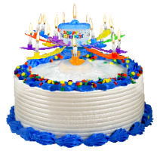

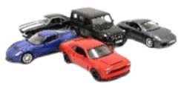




JFL ENTERPRISES AT A GLANCE
CAKE TOPPERS & BALLOONS
Best-in-class retail partner across specialty, mass, party, and grocery
Over 150 products in market, many patented, with millions of pieces sold
2nd Generation, Family Owned and Operated for over 30 years
Category leader, innovator, and the fastest growing brand US Food L52W
DIE-CAST
Category leader in authentic, licensed replica 5” vehicles: Ford, GM, Porsche, and more
TRUSTED BY
FREEZE DRIED CANDY
The best tasting, virally trending candy craze!

Slide 3







Innovation for Every Celebration

Slide 4
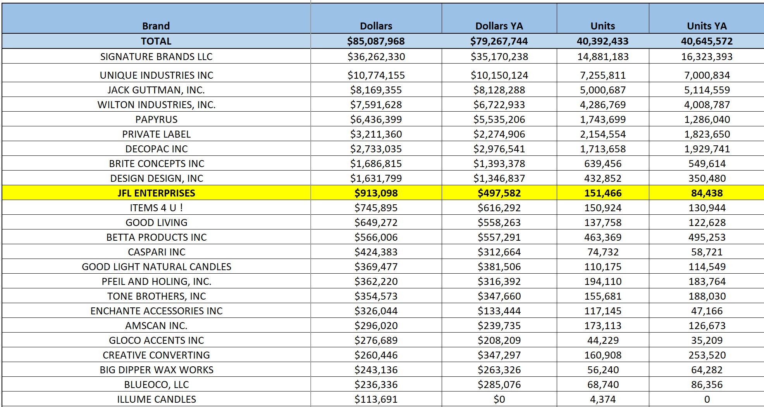
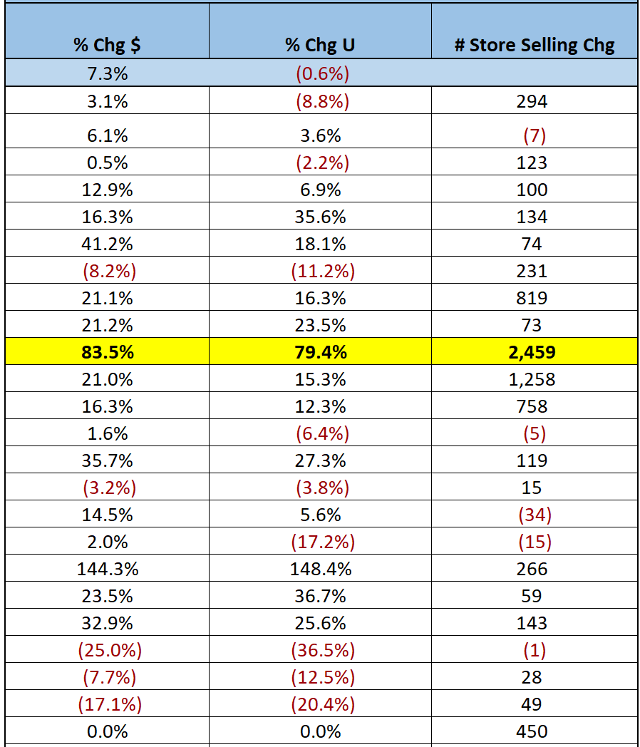
BIRTHDAY CANLDE CATEGORY PERFORMANCE
Source: 52 Weeks Ending 07.15.23
Just for Laughs continues explosive growth in both dollars (+83.5%) and units (+79.4%) in US Food L52W ending 07.15.23. Best Party Ever is the #10 brand and one of the fastest growing in dollars, units and store selling change. JFL adds a unique candle positioning to your current offering!

Slide 5

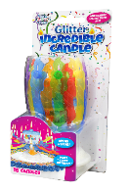
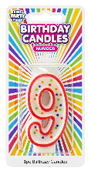
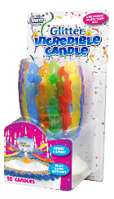



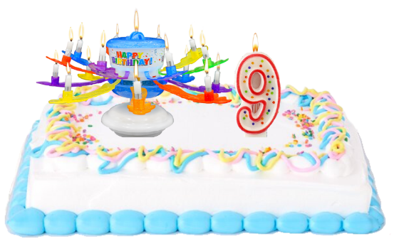
VALUE THAT BUILDS
Best Party Ever! Penny Profit & Margin Enhancement
TRADE CUSTOMERS UP
Our toppers provide more value and profit per sale
 | PRICE | PROFIT
TRADITIONAL CANDLE | $1.29 | $0.58
BPE | $6.99 | $3.14
vs
WHY CHOOSE?
Customers combine our toppers with traditional candles
BOTH | $8.28 | $3.72
+
The icing on the cake?
5x BASKET VALUE & PROFIT

Slide 6
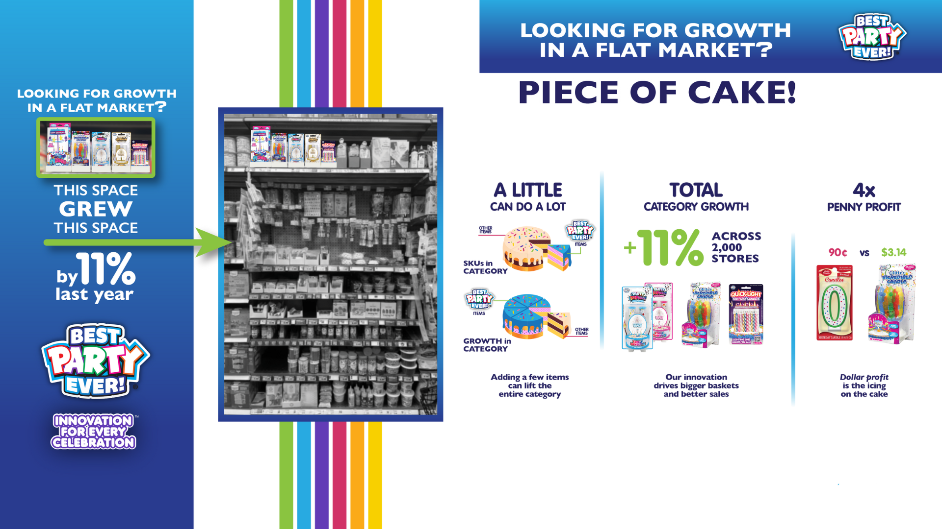

Slide 7
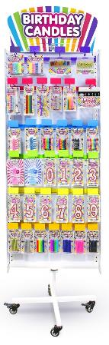
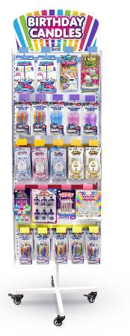

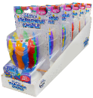


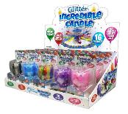
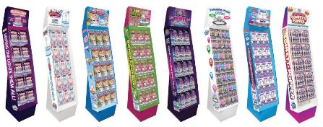
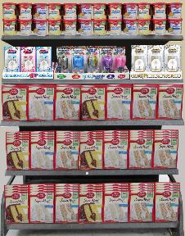
EVERY STORE, EVERY CELEBRATION
Displays & Programs Built for Your Stores
NO PEGS?
NO PROBLEM!
Racks
Floor Displays
Counter Displays
Open Stock
Shelf Ready Packaging makes it easy to add best-sellers above or below in-line POGs
Opportunity for sales growth with promotional tie-in with cake, frosting, etc
Run a new display each quarter and establish your store as a destination for the best party ever!

Slide 8
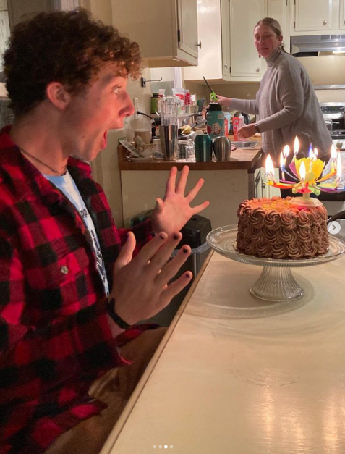
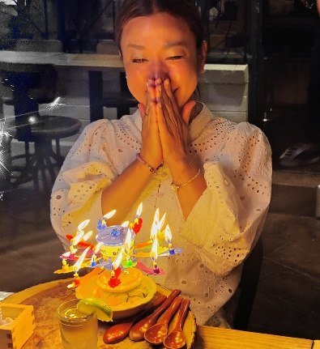
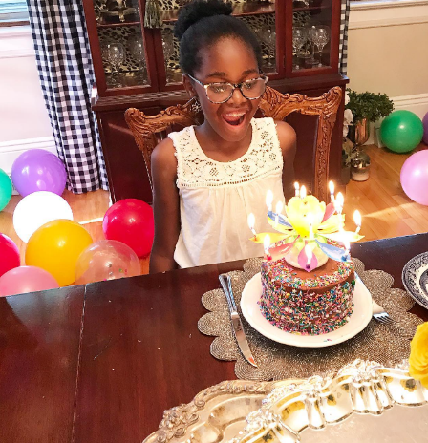
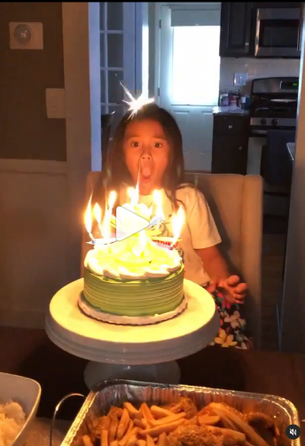
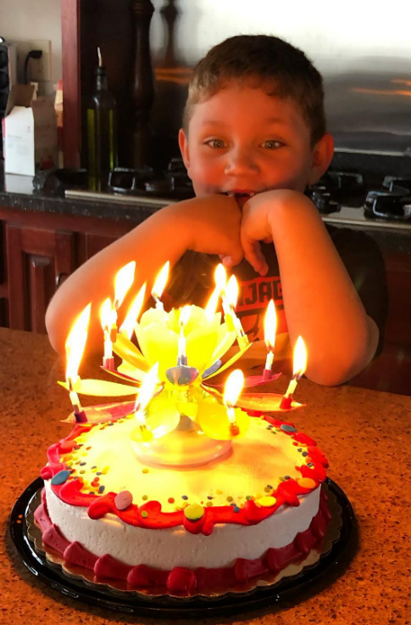


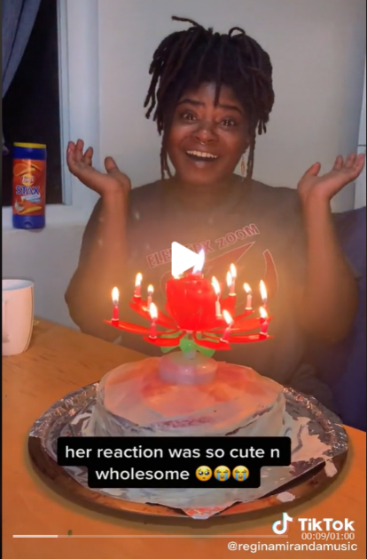
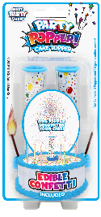
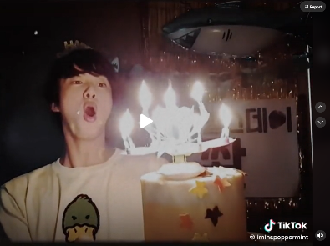
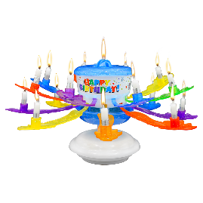

INNOVATION THAT EXCITES
Our unique products make every celebration the Best Party Ever! for friends and family to share fun and happiness
NEW FOR 2024!
Sprinkle Fountain
Lazer Balloons
and more!
2023
Butterfly Surprise
Tune-A-Loons
2019
Party Popper! Cake Topper
2015
Incredible Candle

Slide 9
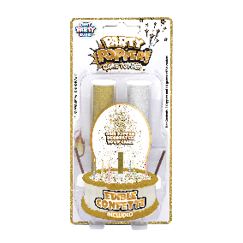
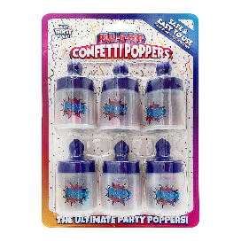
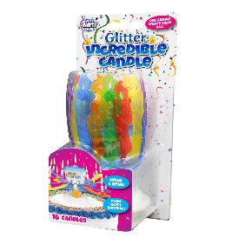
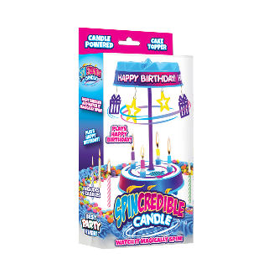

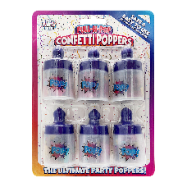
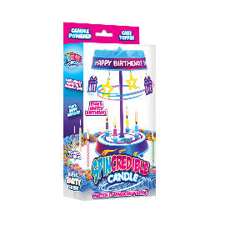
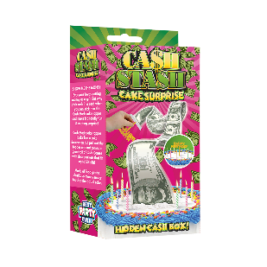
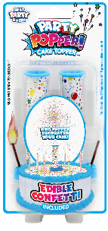
SPECIALTY CELEBRATION CANDLE ANNUAL DISPLAY PROGRAM TIMING
JANUARY
FEBRUARY
MARCH
APRIL
MAY
JUNE
JULY
AUGUST
SEPTEMBER
OCTOBER
NOVEMBER
DECEMBER

Slide 10
DISPLAY
PROGRAMS

Slide 11
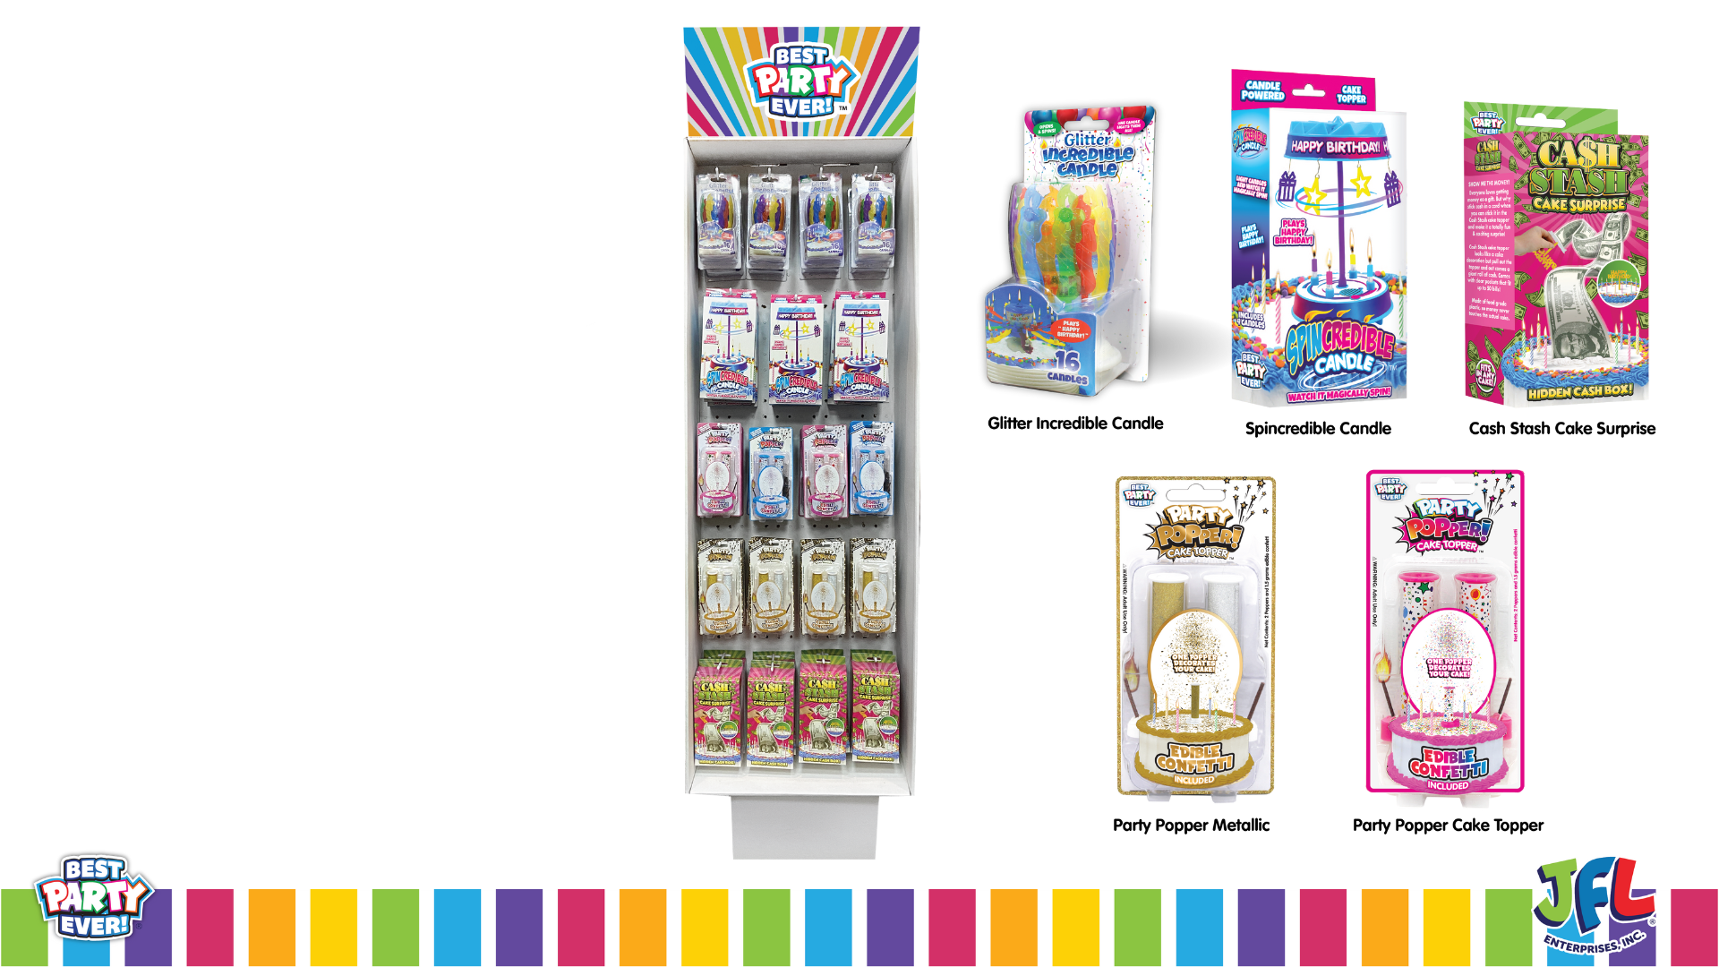
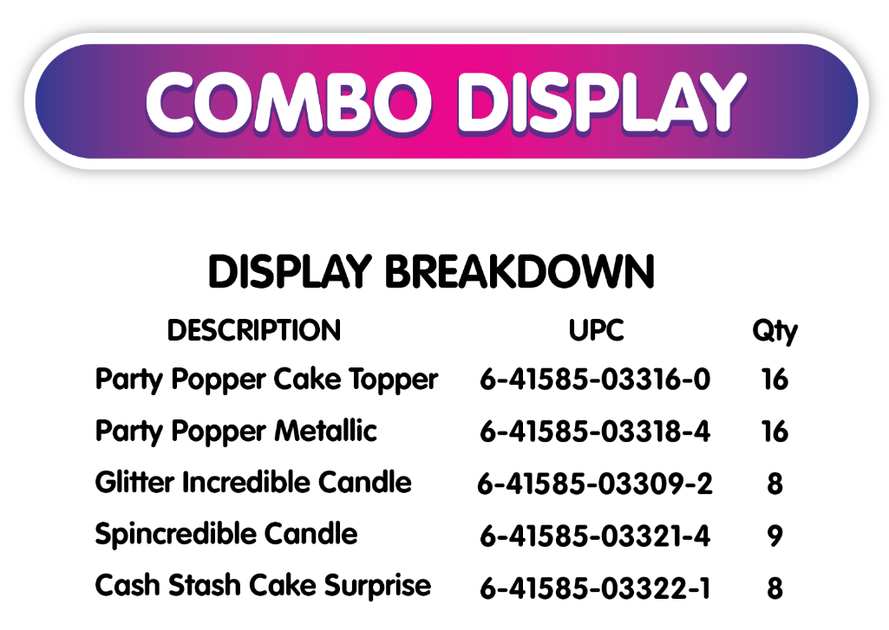

Cost = $219.45
Retail = $398.43
GM $ = $178.98
GM % = 45%

Slide 12
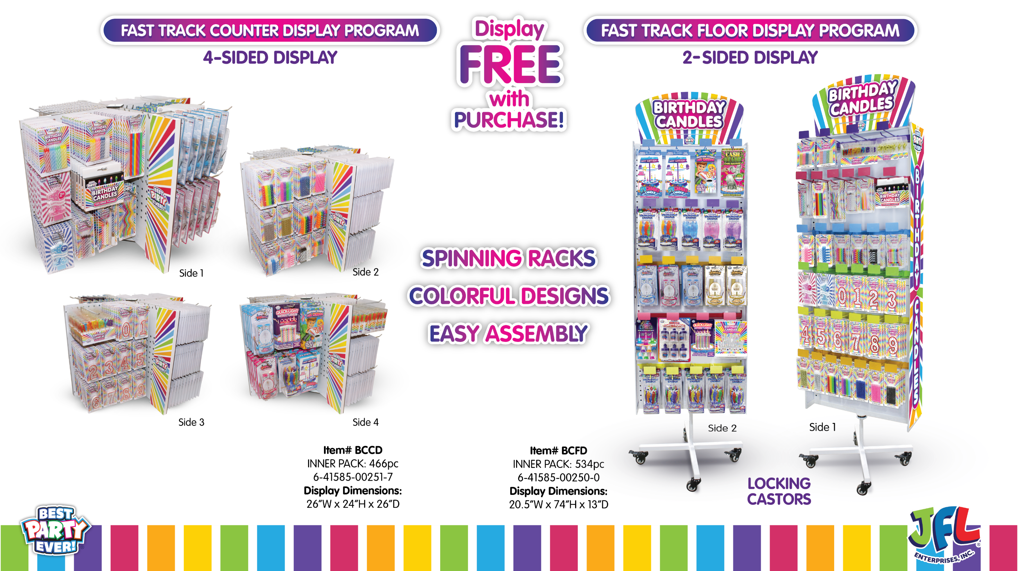

Slide 13
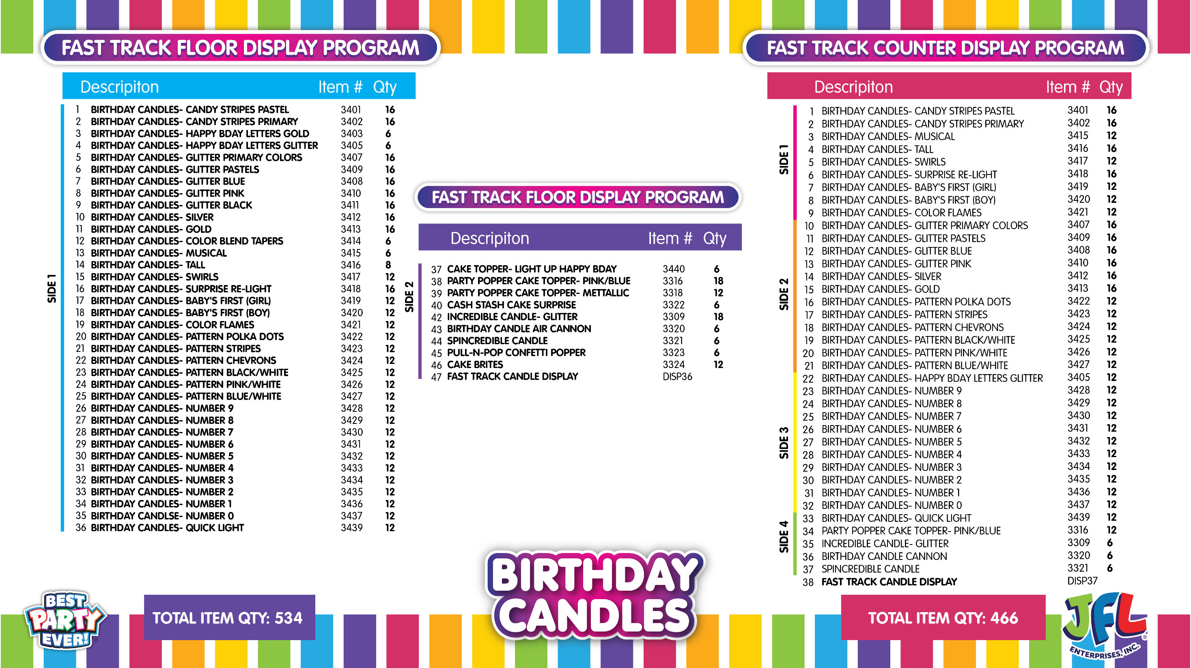

Slide 14
PRODUCT
SELL SHEETS

Slide 15


Slide 16


Slide 17


Slide 18
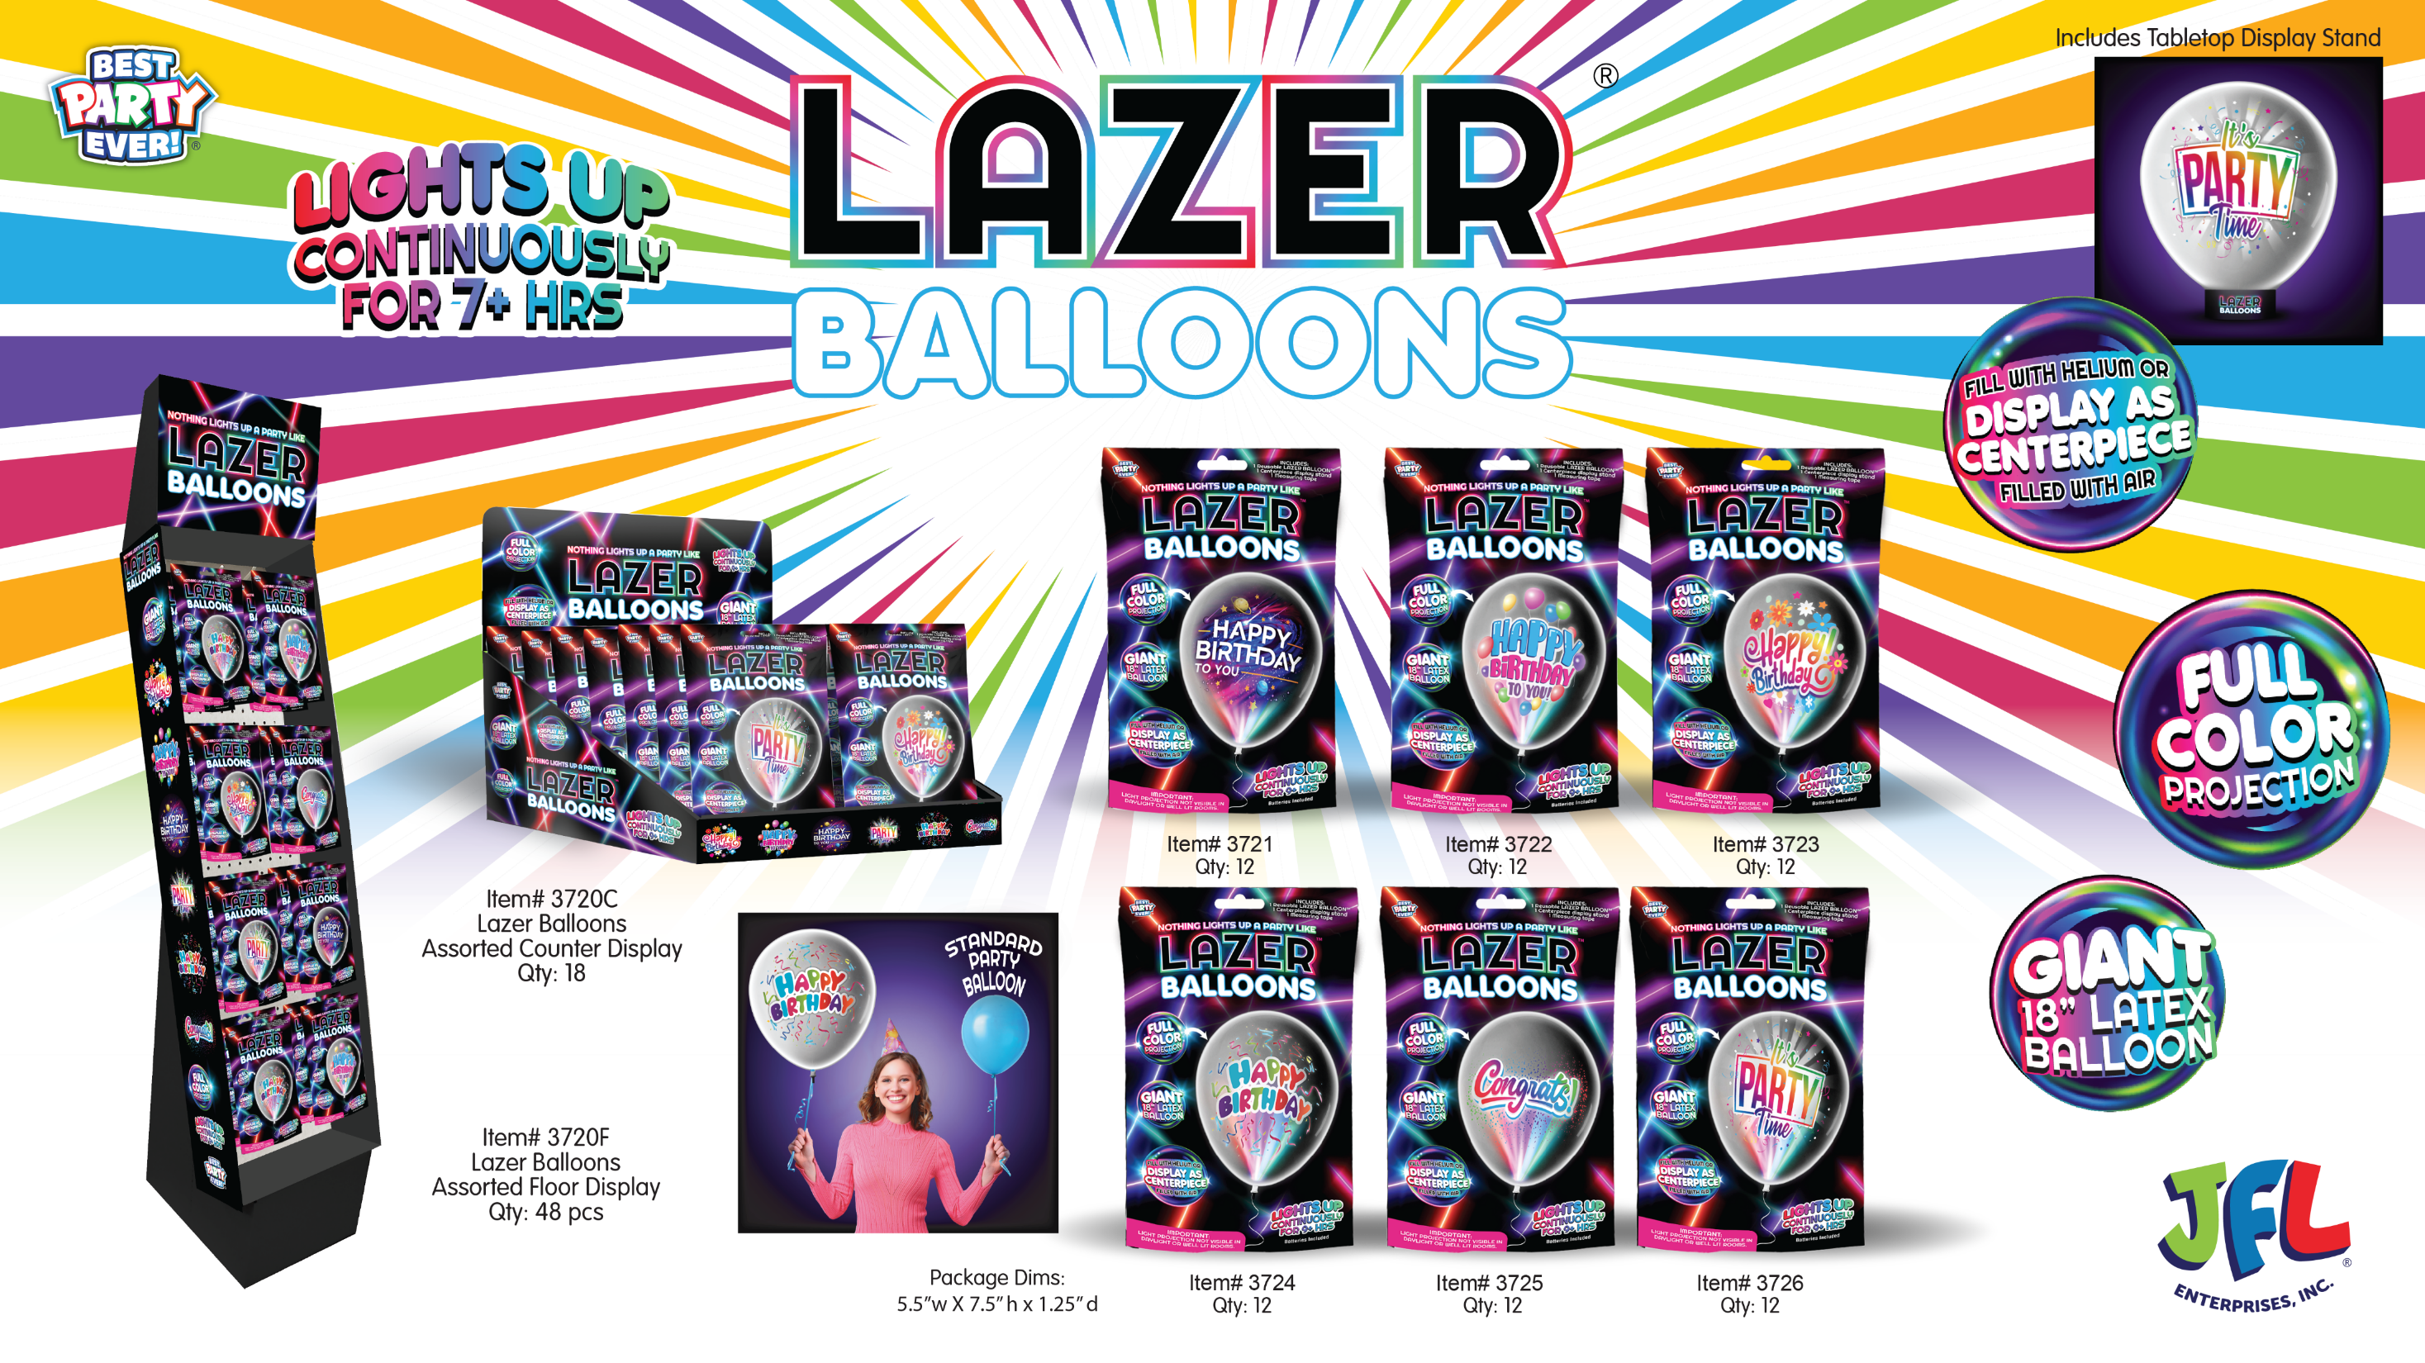

Slide 19


Slide 20
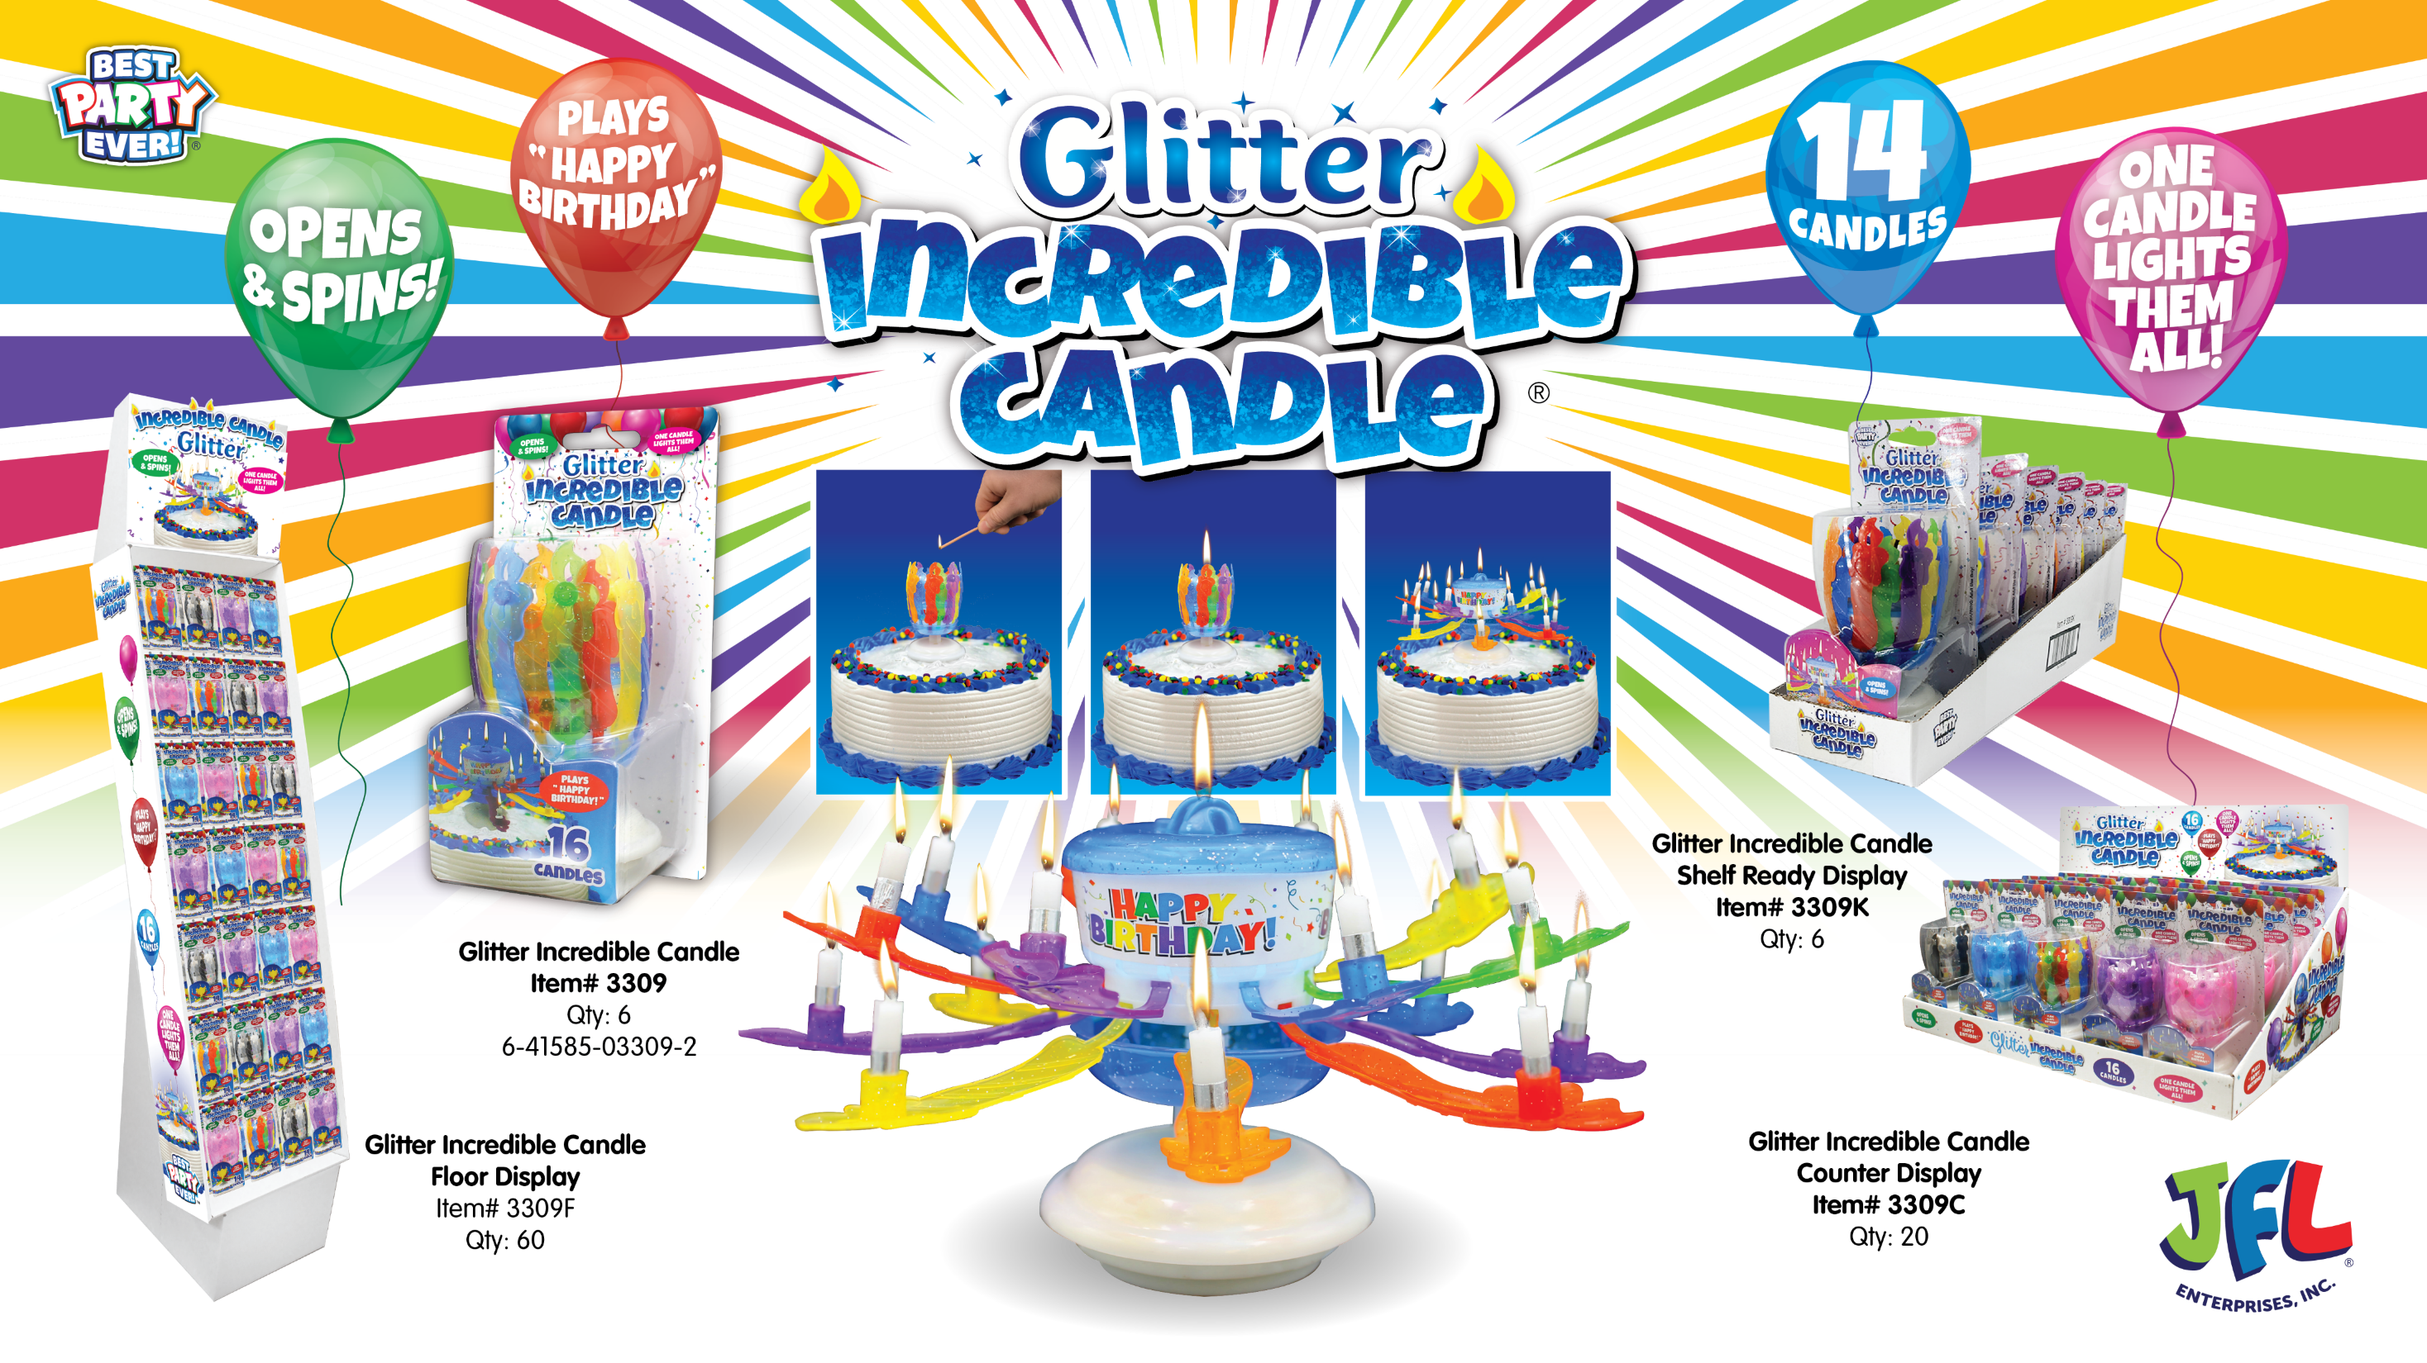

Slide 21
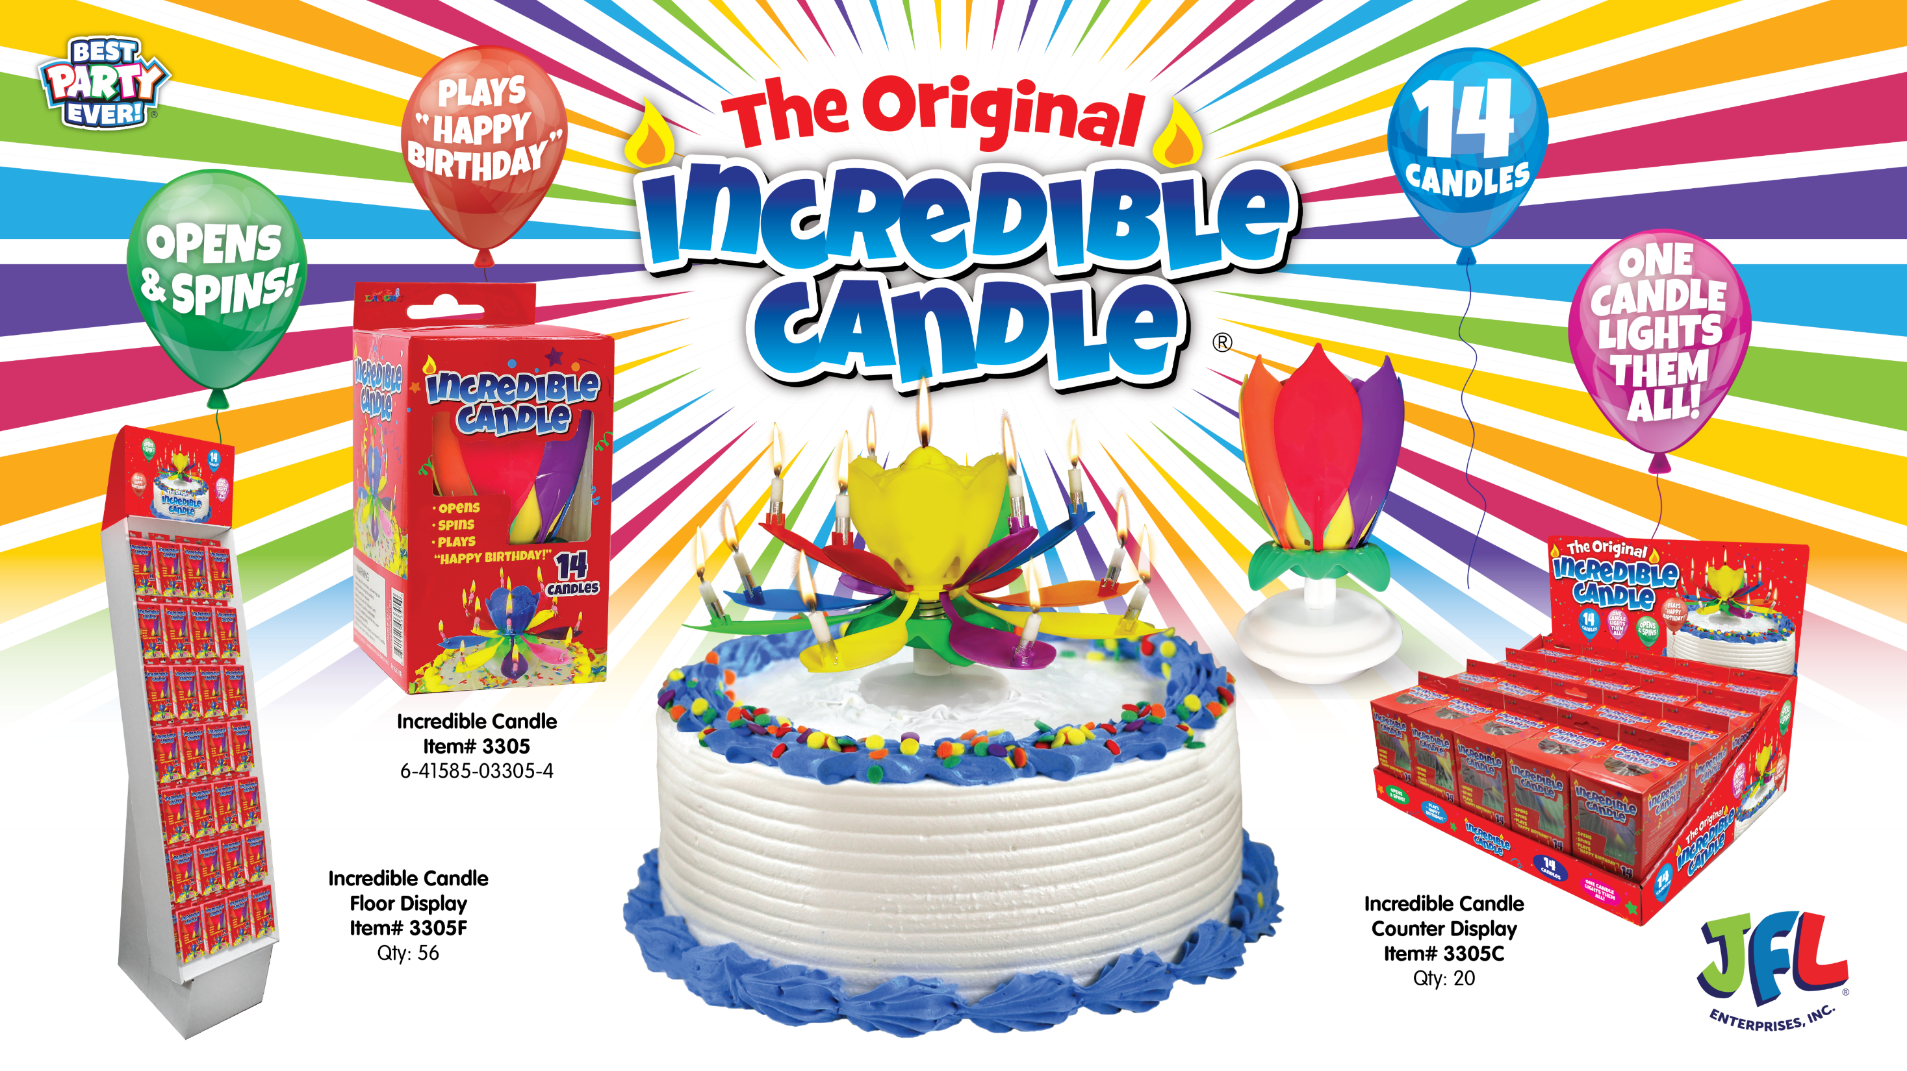

Slide 22
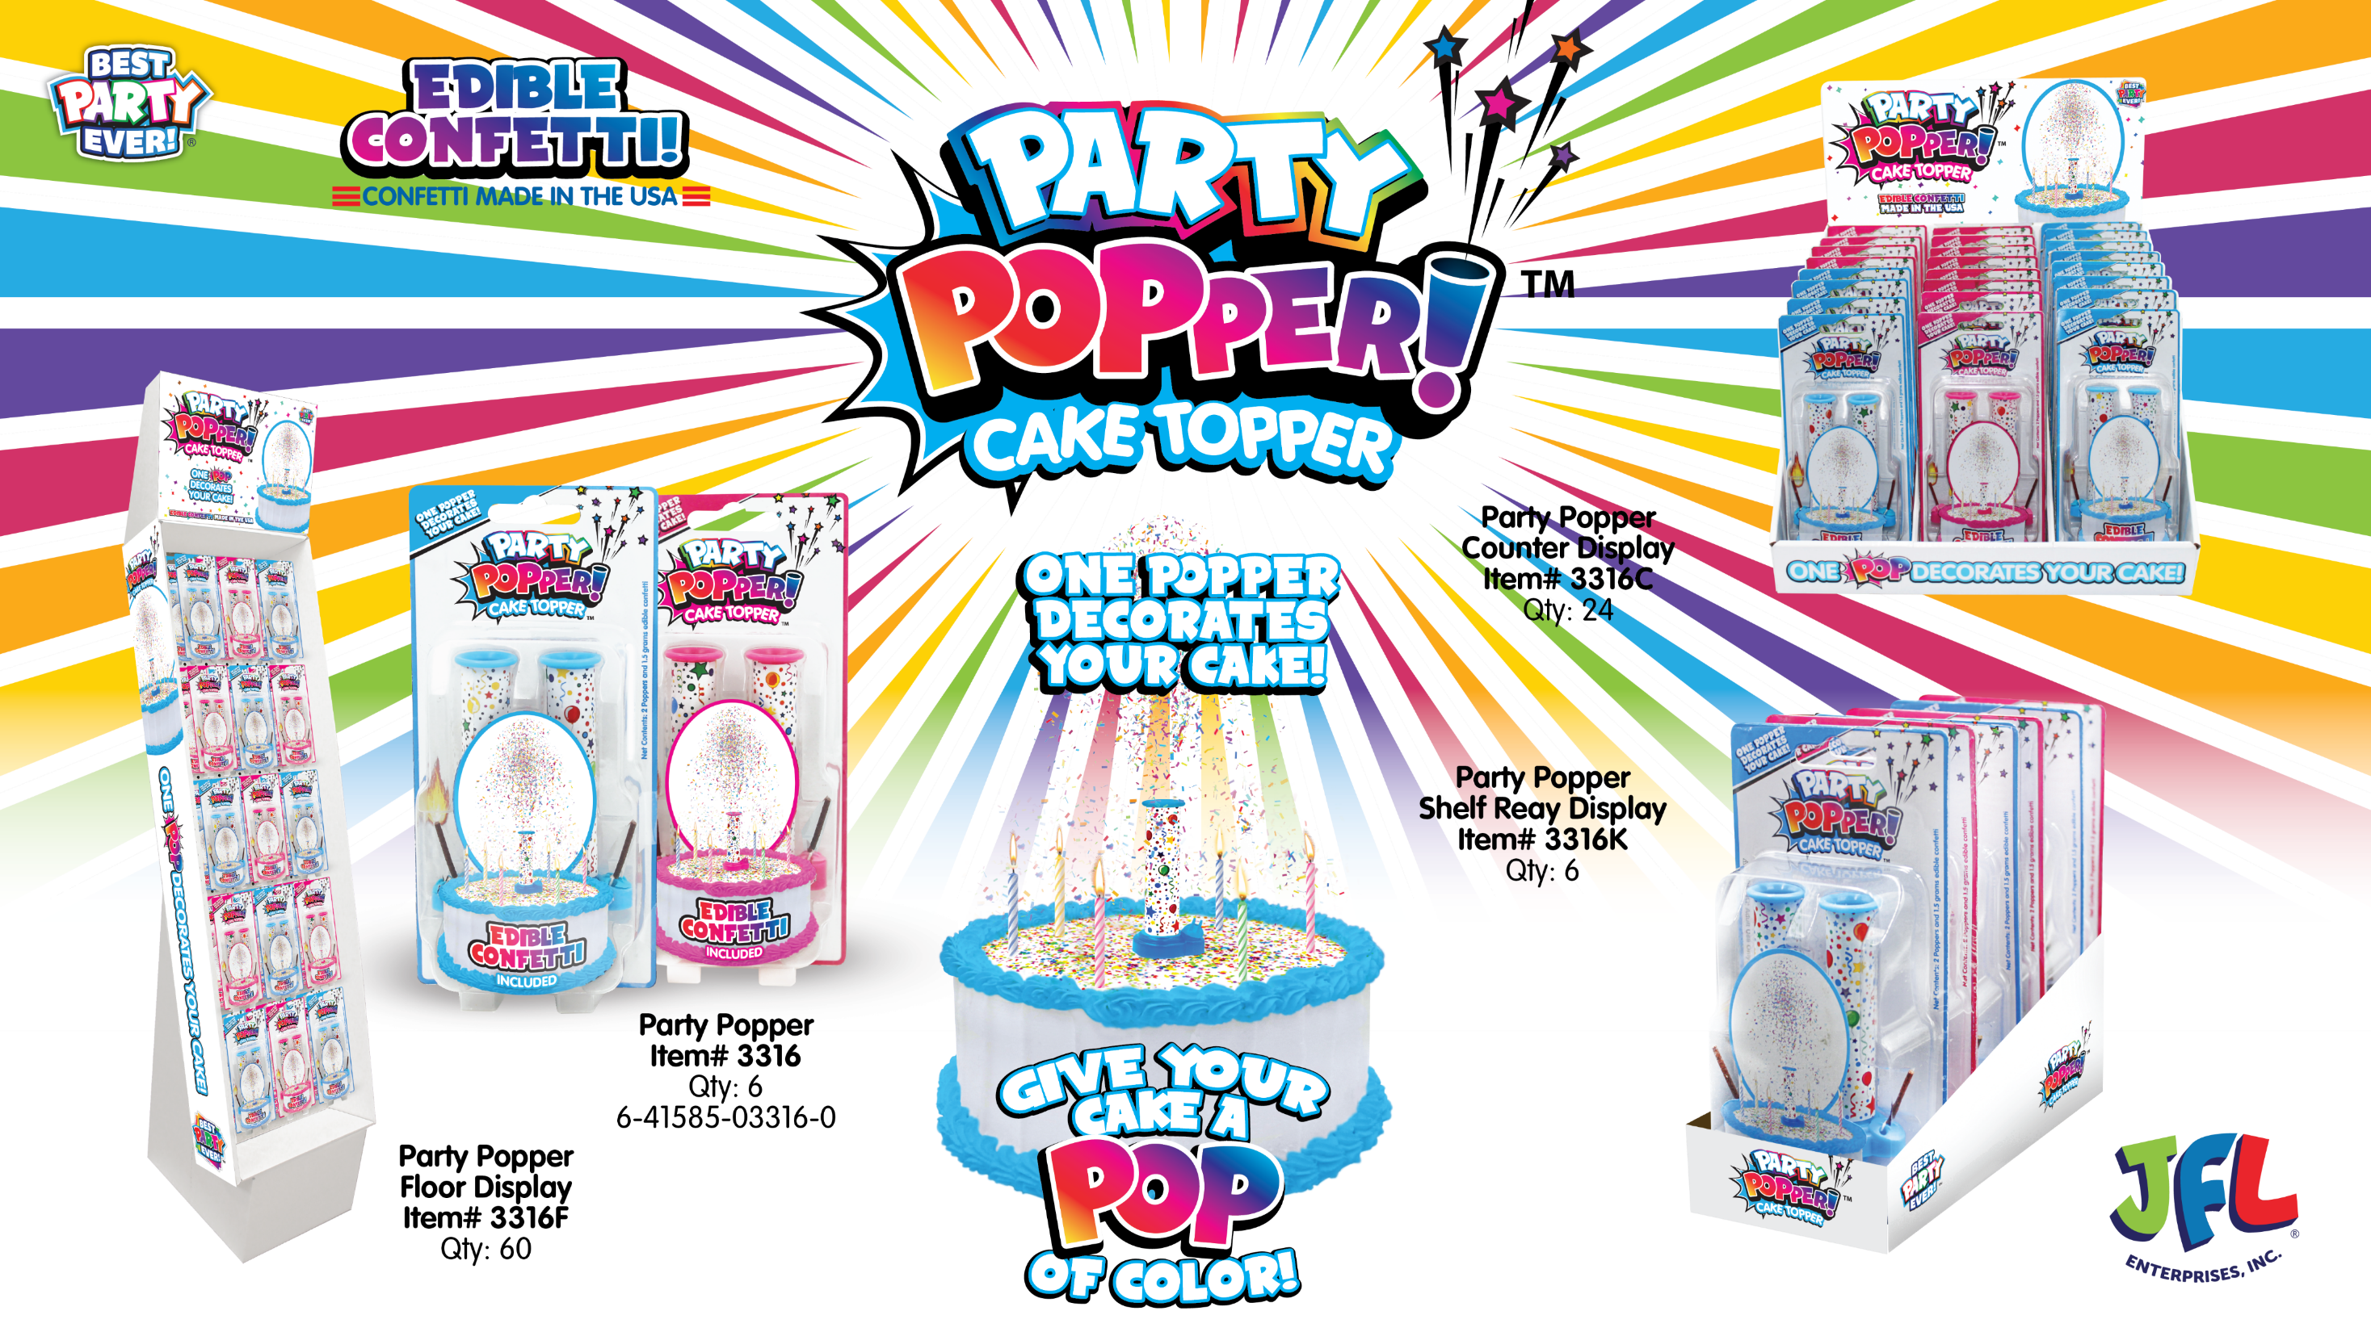

Slide 23


Slide 24
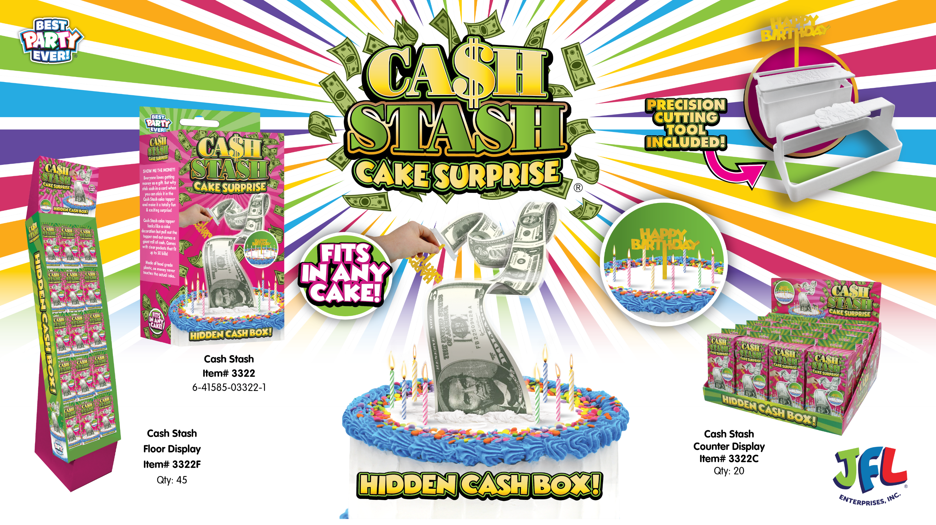

Slide 25
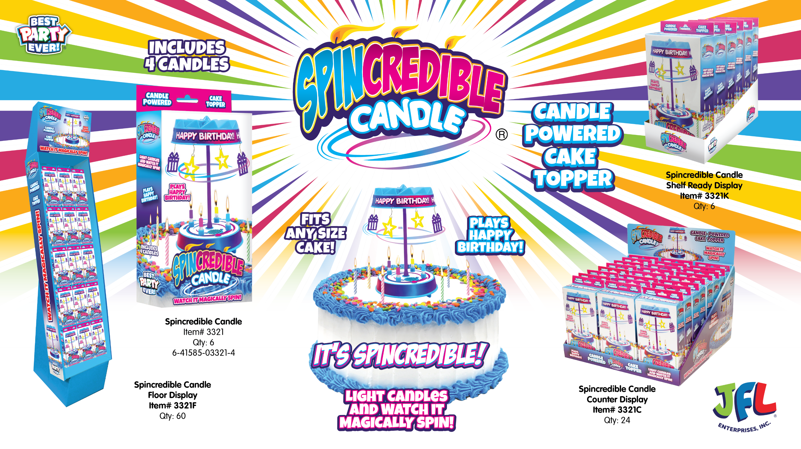

Slide 26
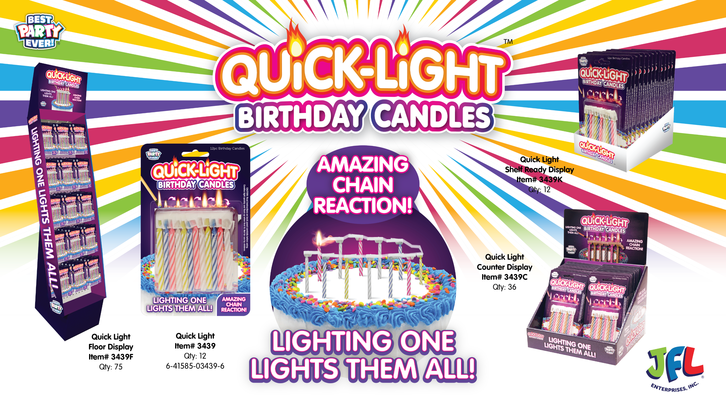

Slide 27
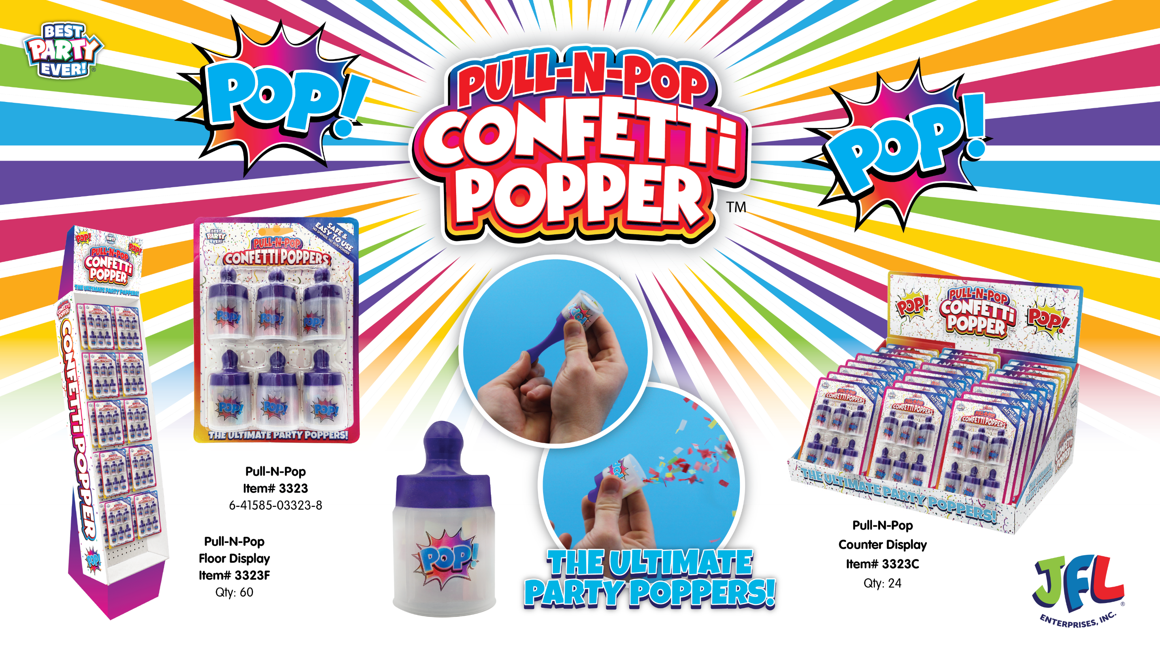

Slide 28
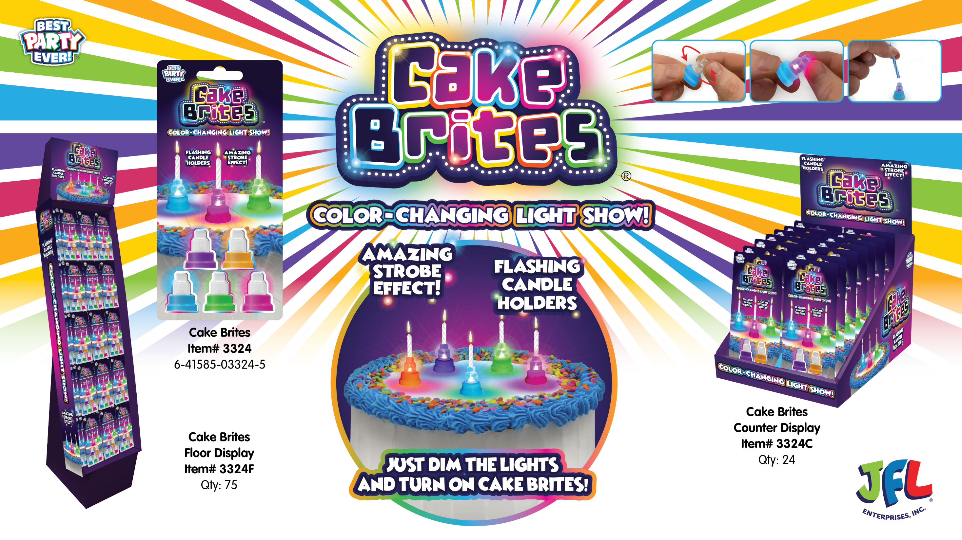

Slide 29
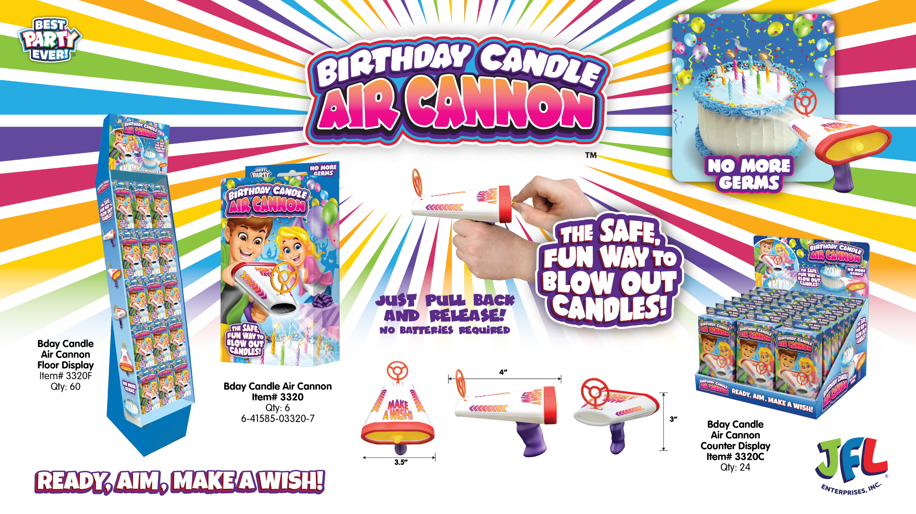

Slide 30
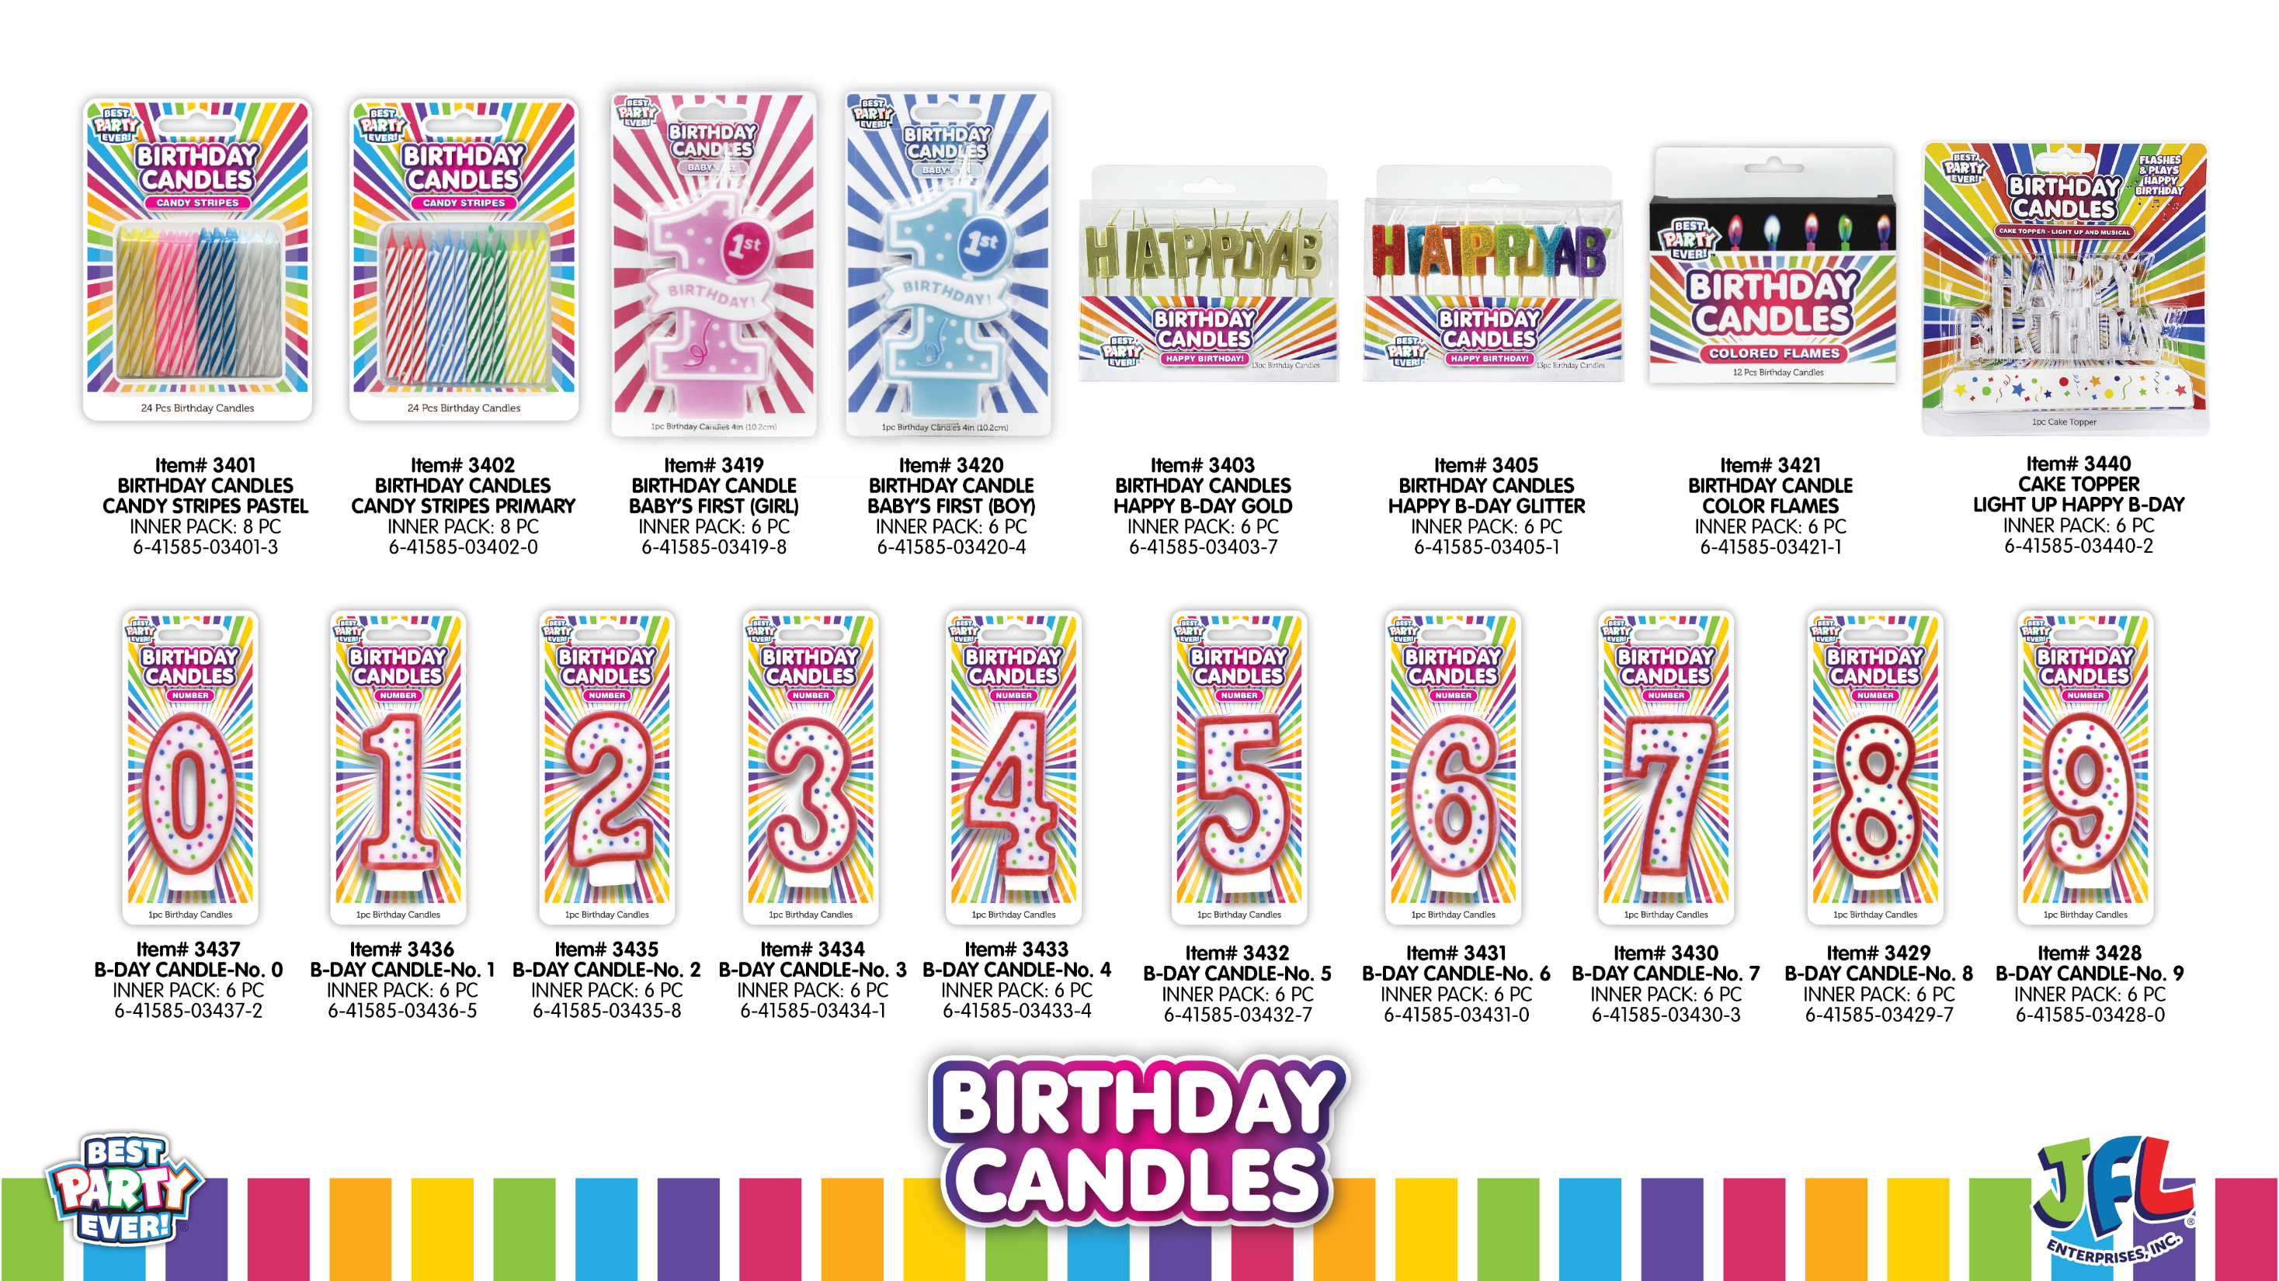

Slide 31
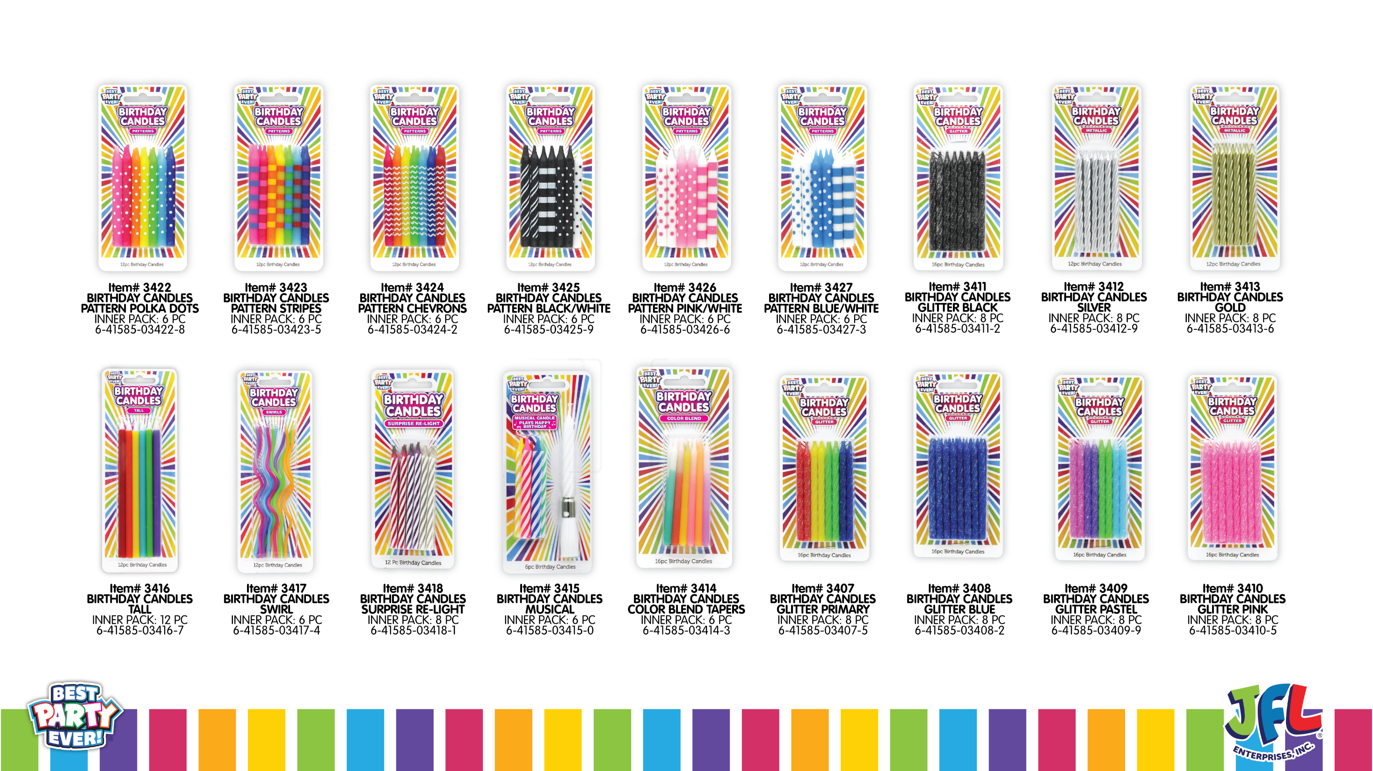

Slide 32
APPENDIX

Slide 33


RETAILER LOGO
2024 Line Review
March 1, 2024
Presented To: [Buyer Name]
The Fastest Growing
and Most Innovative Company
in the Celebration Aisle Today

Slide 34


Presented To: [Buyer Name]
RETAILER LOGO
2024 Line Review
March 1, 2024

Slide 35
WE DISRUPT CATEGORIES
BY INNOVATING THE AISLE
AND DELIVERING GREAT SERVICE
Presented To: [Buyer Name]
RETAILER LOGO
2024 Line Review
March 1, 2024
The Fastest Growing and Most Innovative
Company in the Celebration Aisle Today

Slide 36

























INDIVIDUAL RETAILER LOGOS

